Slide 1
Jupyter Notebook & Pandas

Slide 2
Why Jupyter Notebook?
Easier to use
In-line processing – see results pretty and immediately
A standard of DS
Comes with DS packages already installed

Slide 3
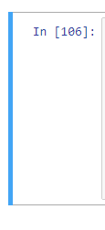
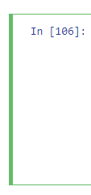
Command and Edit Mode
Command Mode
Edit Mode
Click inside cell and hit Escape
a - add cell above
b – add cell belo w
m – change to markdown
Double click inside cell
Shift + Enter runs code

Slide 4
pandas
Your primary data science package
Read in and view data
Stores data in a data frame
Data wrangling
Summary statistics
You must import it to use it!
import pandas as pd

Slide 5
Creating dataframes from Scratch
You provide data and column names
df = pd.DataFrame(data = [[1,2,3], [4,5,6],
[7,8,9]],
columns = [‘column1’, ‘column2’, ‘column3’])

Slide 6
Importing .csv and Excel Files
CSVs
df_csv = pd.read_csv(“filepath/filename.csv”)
Excel files
df_excel = pd.read_excel(“filepath/filename.xlsx”)

Slide 7
Subsetting Dataframes
Isolating one column
df.columnName
df[‘columnName’]
Accessing multiple columns
df[[‘column1’, ‘column2’, ‘column3’]]

Slide 8
Multiple Summary Statistics
Continuous
df.describe()
Categorical
df.describe(include=[‘O’])

Slide 9
IndividualSummary Statistics
Mean
df.column.mean()
Standard Deviation
df.column.std()
Median
df.column.median()
Frequencies
df.column.value_counts()

